Slide 1
Lecture -3
Conditionals

Slide 2
We’ll Learn Today
Conditionals
If Statements
Ternary Conditions
Switch Statements
Exercise

Slide 3
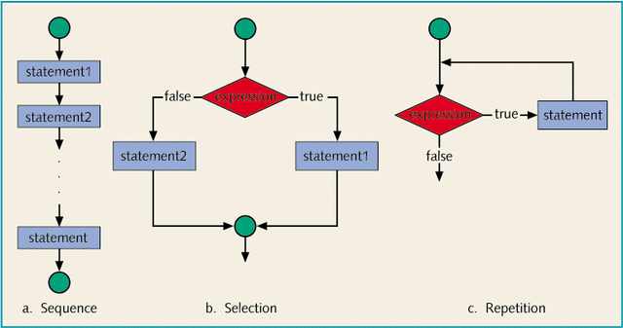
Logic Building Block
Three ways that a computer can proceed:

Slide 4
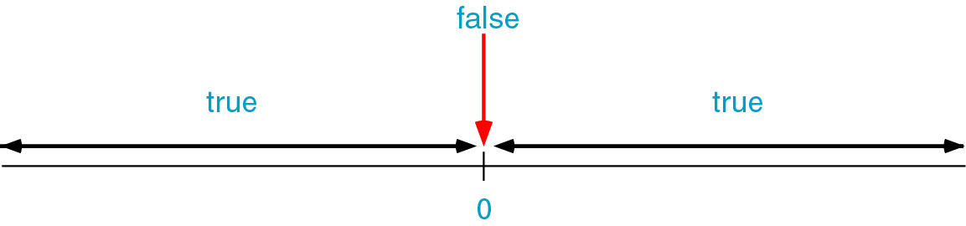
Conditional Statements
In C, a condition is represented by a logical (Boolean) expression.
true
false
If a data item is zero, it is false.
If a data item is non-zero, it is true.
 | if(score is greater than or equal to 87) grade is A
A condition is met if it evaluates to true.

Slide 5
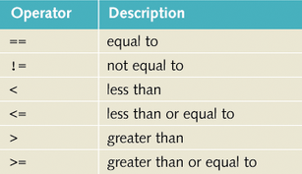
Relational Operators
A relational operator allows you to make comparisons in a program.
They are all binary operators and can accept two operands.
Equality of real numbers is usually machine dependent. It is quite possible that on a particular machine
In C, any nonzero value is treated as true.
6.8 + 3.1 == 2.7 + 7.2 is false
Expression | Meaning | Value
8 < 15 | 8 is less than 15 | 0
6 != 6 | 6 is not equal to 6 | 1
2.5 > 5.8 | 2.5 is greater than 5.8 | 0
5.9 <= 7.5 | 5.9 is less than or equal to 7.5 | 1

Slide 6
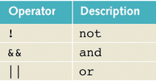
Logical (Boolean) Operators
Logical (Boolean) operators enable you to combine logical expressions
Logical operators take only logical values as operands and yield only logical values as results.
In C, there are three logical (Boolean) operators:
The operator ! is unary, so it has only one operand, and only two possible outcome.
The operators && and || are binary operators, and can have four possible combinations of values in its operands.

Slide 7
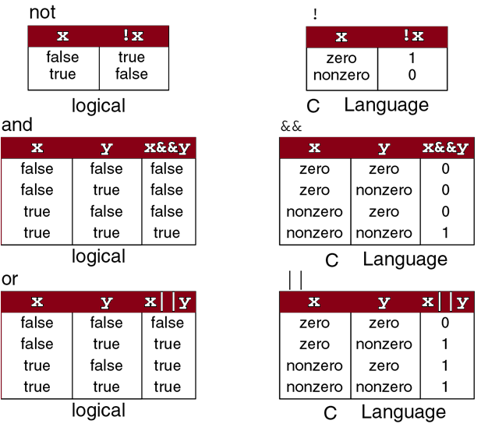
Truth table for Logical operators

Slide 8
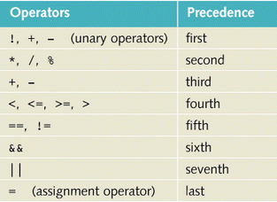
Order of Precedence
Consider the logical expression:
11 > 5 || 6 < 15 && 7 >= 8
This logical expression will yield different results if || is evaluated first or && is evaluated first.
If || is evaluated first, this logical expression evaluates to 0 (false).
If && is evaluated first, this logical expression evaluates to 1(true).
Because relational and logical operators are evaluated from left to right, the associativity of these operators is said to be from left to right.

Slide 9
Selection: if ... else
Selection
if
One – way selection
Two – way selection
Multiple selection
switch
In C, there are two branch control structures:
if statements
switch structure
First we discusses how if and if...else statements can be used to create one-way selection, two-way selection, and multiple selections.

Slide 10
One-way Selection
statement 1
Statements 1 and 3 are always executed
If the value of the expression is true, statement2 is executed;
statement1;statement2;statement3;
if the value is false, statement is not executed and the computer goes on to the next statement in the program.
statement1;statement3;
The expression in the if statement is sometimes called a decision-maker because it decides whether to execute the statement or not.
The expression is usually a logical expression.
In C, if is a reserved word.
False
Expression
True
statement2
statement3
statement1;
if(expression)
statement2;
statement3;

Slide 11
One-way Selection : The Absolute Value
#include <stdio.h>
int main ()
{
int number;
printf("Please enter an integer--> “);
scanf(“%d”, &number);
if(number < 0)
number = -number;
printf("The absolute value is %d“,
number);
return 0;
}
start
Print
Enter an integer
Input
number
False
Number < 0
True
Number= -number
Print
Absolute Value
Please enter an integer--> -6734
The absolute value is 6734
stop

Slide 12
Two-way Selection
statement1
False
Expression
True
Statement1 and statement4 are always executed
In a two-way selection if the value of the expression is true, statement2 is executed leading to
Statement1;
Statement2;
Statement4;
If the value of the expression is false, statement3 is executed.
Statement1;
Statement3;
Statement4;
statement3
statement2
statement4
statement1;
if(expression)
statement2;
else
Statement3;
statement4;

Slide 13
Two-way Selection: Weekly Wage
start
#include <stdio.h>
int main ()
{
float wages, rate, hours;
printf("Enter working hours and rate:");
scanf(“%f %f”, &hours, &rate);
if(hours > 40.0)
wages = 40.0*rate+1.5*rate*(hours-40.0);
else
wages = hours * rate;
printf("The wages are %.2f“,wages);
return 0;
}
print
working hours
Input
Hours rates
False
Expression
True
Wages=
40.0*rates…
Wages=
hours*rates
output
Wages are
Line 2: Enter working hours and rate: 56.45 12.50
Line 9: The wages are $808.44
end

Slide 14
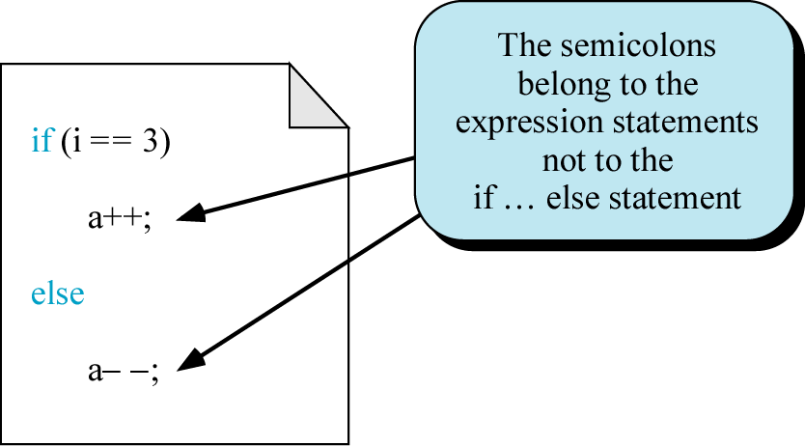
Syntactical Rules for if…else Statements
Rule #1 The expression must be enclosed in parentheses
Rule #2 No semicolon (;) is needed for an if…else statement.
if score >= 90
grade = 'A';
if (score >= 90)
grade = 'A';

Slide 15
Syntactical Rules for if…else Statements
Rule #3
Both the true and the false statements can be any statement or can be a null statement.
if(score >= 90); // Line1
grade = ‘A’; // Line2
Because there is a semicolon at the end of the expression, the if statement terminates at Line 1, the action of the if statement is null, and the statement at Line 2 is not part of the if statement at Line 1.

Slide 16
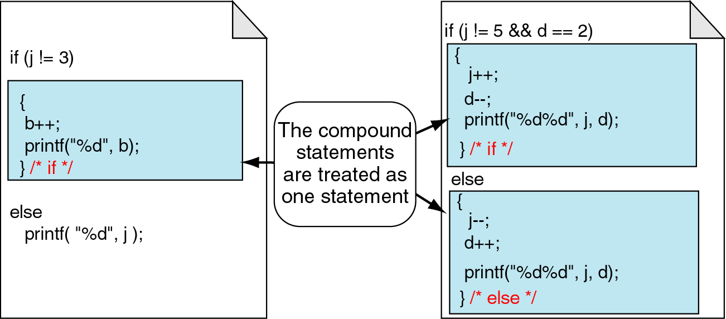
Syntactical Rules for if…else Statements
Rule #4
Both statement1 and statement2 must be one and only one statement. However, multiple statements can be combined into a compound statement by using braces.
{
j++;
d--;
cout >> j>>d;
} /* if */
{
b++;
cout >> b;
} /* if */
{
j--;
d++;
cout >> j>>d;
} /* else */
cout >> j;

Slide 17
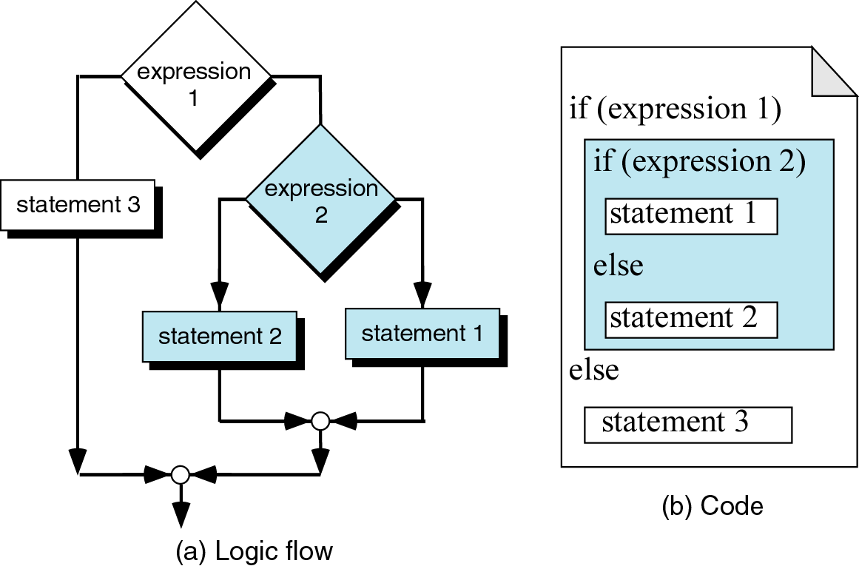
Multiple Selections: Nested if
There is a way of considering multiple selections using if...else, if we permit the action statement itself to be an if... statement. When one control statement is within another, it is said to be nested.

Slide 18
Multiple Selection: Even Number
#include <stdio.h>
int main(void)
{
int test;
printf("Enter an integer");
scanf(" %d", &test);
if(test % 2 == 0)
{
printf("The number %d is even", test);
if((test/2) % 2 == 0)
{
printf("\nHalf of %d is also even", test);
printf("\nThat's interesting isn't it?\n");
}
} else printf("The number %d is odd\n", test);
return 0; }

Slide 19
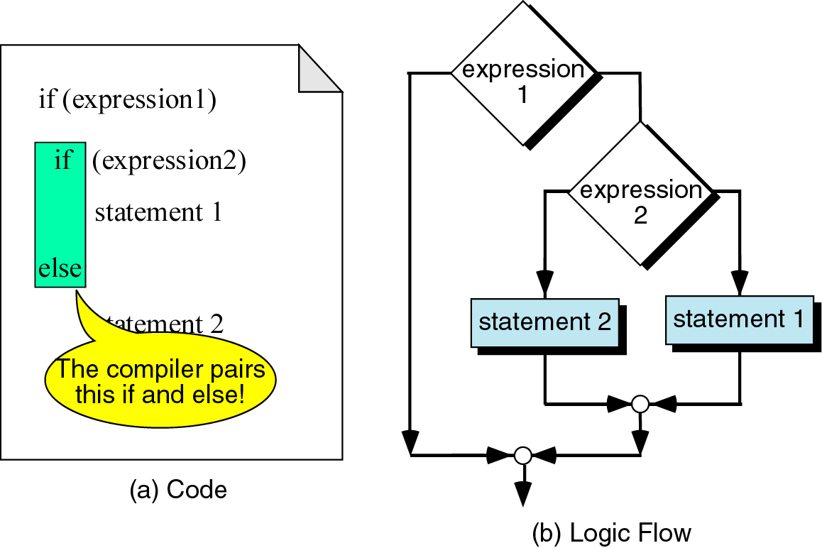
Dangling else Problem
When there is no matching else for every if, else is always paired with the most recent unpaired if.

Slide 20
The ? Operator
The ? (ternary condition) operator is a more efficient form for expressing simple if statements. It has the following form:
expression1 ? expression2: expression3
It simply states:
if expression1 then expression2 else expression3

Slide 21
The ? Operator (con’t)
For example to assign the maximum of a and b to z:
z = (a>b) ? a : b;
which is the same as:
if (a>b)
z = a;
else
z=b;

Slide 22
The switch Statement
The C switch is similar to Pascal's case statement and it allows multiple choice of a selection of items at one level of a conditional where it is a far neater way of writing multiple if statements:
switch (expression) {
case item1:
statement1;
break;
case item2:
statement2;
break;
case itemn:
statementn;
break;
default:
statement;
break;
}

Slide 23
The switch Statement (con’t)
In each case the value of item must be a constant, variables are not allowed.
The break is needed if you want to terminate the switch after execution of one choice. Otherwise the next case would get evaluated.
We can also have null statements by just including a : or let the switch statement fall through by omitting any statements (see e.g. next slide).

Slide 24
The switch Statement (con’t)
For example:-
switch (letter)
{
case `A':
case `E':
case `I':
case `O':
case `U':
numberofvowels++;
break;
case ` ':
numberofspaces++;
break;
default:
numberofconstants++;
break;
}

Slide 25
The switch Statement (con’t)
In the above example if the value of letter is `A', `E', `I', `O' or `U‘ then numberofvowels is incremented.
If the value of letter is ` ' then numberofspaces is incremented.
If none of these is true then the default condition is executed, that is numberofconstants is incremented.

Slide 26
Nested Switch
It is possible to have a switch as a part of the statement sequence of an outer switch. Even if the case constants of the inner and outer switch contain common values, no conflicts will arise.
switch(ch1)
{
case 'A':
printf("This A is part of outer switch" );
switch(ch2)
{
case 'A': printf("This A is part of inner switch" );
break;
}
break;
case 'B': /* case code */ }

Slide 27
Nested Switch
{
case 0:
printf("The number is even");
break;
case 1:
printf("The number is odd");
break;
}
}
return 0;
}
#include <stdio.h>
int main(void)
{
int x;
int y;
printf("Enter a number: ");
scanf("%d",&x);
switch(x)
{
case 0:
printf("The number is 0");
break;
default:
y=x%2;
switch(y)

Slide 28
Exercise (Class Work)
Read an integer value. Assume it is the number of a month of the year; print out the name of that month.
Write a program which reads two integer values. If the first is less than the second, print the message up. If the second is less than the first, print the message down If the numbers are equal, print the message equal If there is an error reading the data, print a message containing the word Error and perform exit( 0 ).

Slide 29
Exercise (Home Work)
If the ages of Wasim Akram, Javaid Miandad and Imran Khan are input through the keyboard, write a program to determine the youngest of the three.
Write a program to check whether a triangle is valid or not, when the three angles of the triangle are entered through the keyboard. A triangle is valid if the sum of all the three angles is equal to 180 degrees.

